Slide 1
Control Systems
EE 447 Fa21 MW 12:30—2:20p in NAN 181
Prof Burden
(Sam; he/him/his)

Slide 2
why take this course?

Slide 3
This course focuses on analysis and design of (linear) feedback control systems.
You will learn to understand and engineer control in robotics, embedded systems, electrical circuits, power systems, and biology.
We’ll build on your background in calculus, signal processing, and linear algebra, providing new analytical and computational tools.

Slide 4
learning outcomes
by the end of this course, you will be able to:
represent a linear system in state space and transfer function form;
determine the effects caused by including feedback in a system;
linearize a nonlinear system around an operating point;
determine if a system is stable;
understand sensitivity and noise/disturbance rejection properties;
apply scientific computing tools to model, design and simulate systems;
determine the performance of a system analytically and from simulation;
apply root locus, frequency response and full-state feedback methods to design a feedback control system to meet performance requirements;
design a full-state observer for a system;
apply observer + controller to estimate and stabilize a system’s state.

Slide 5
origins of feedback control

Slide 6

Otto Mayr
“The Origins of Feedback Control”
MIT Press 1970

Slide 7
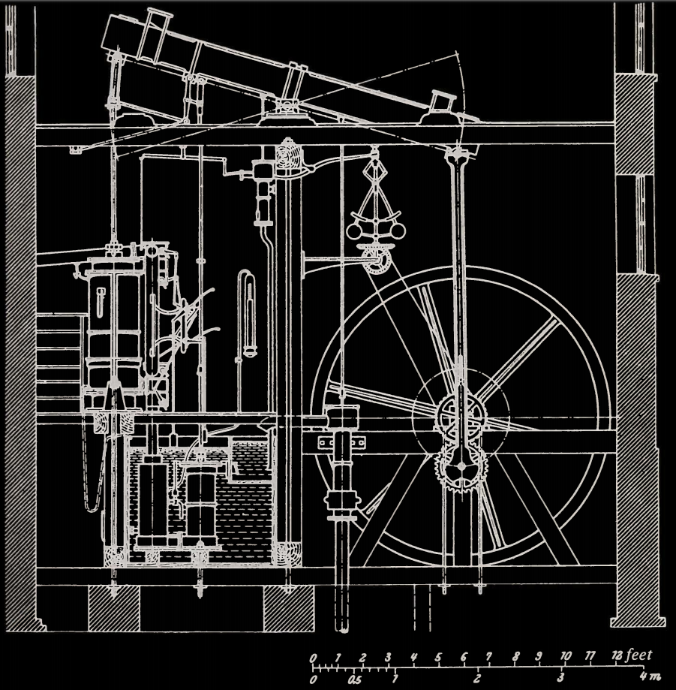
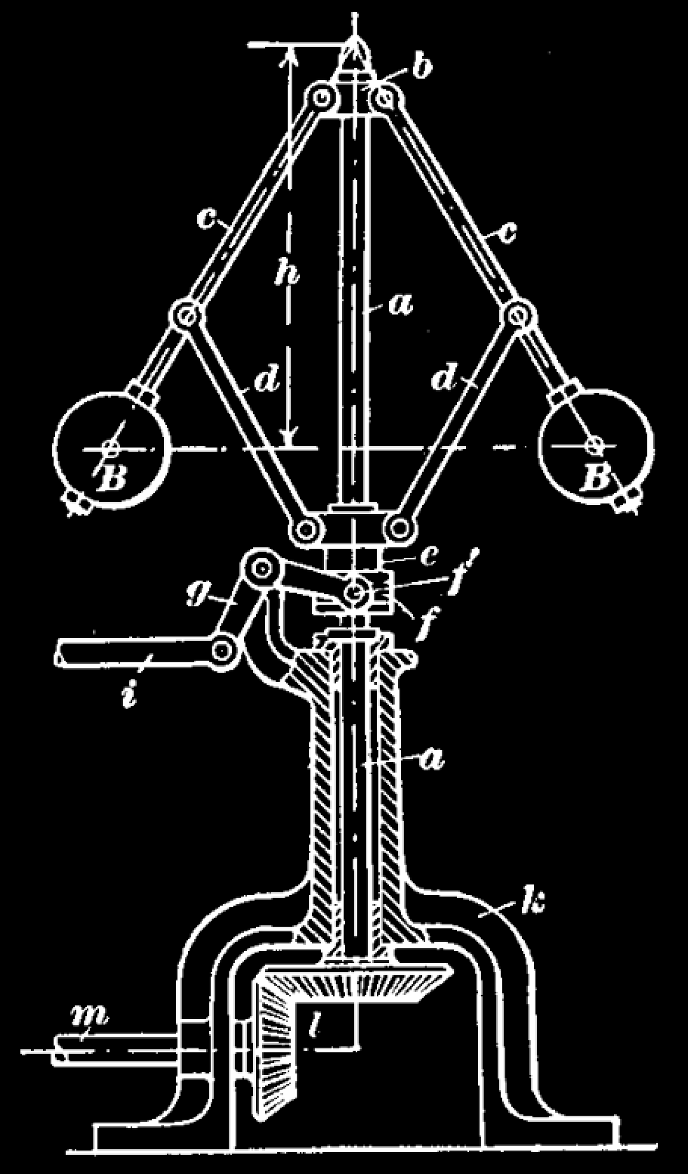
≈1800 CE

Slide 8
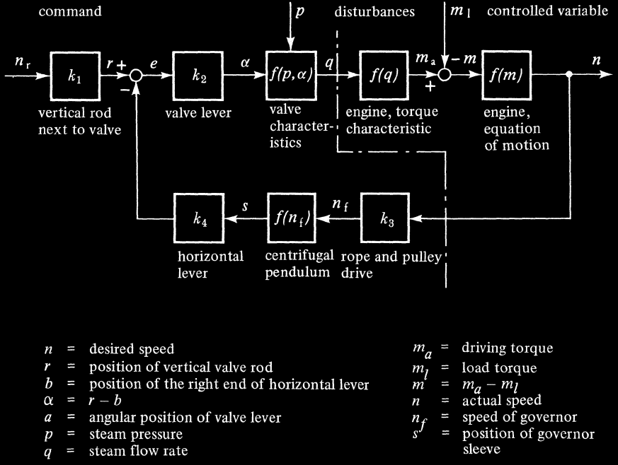
≈1800 CE

Slide 9
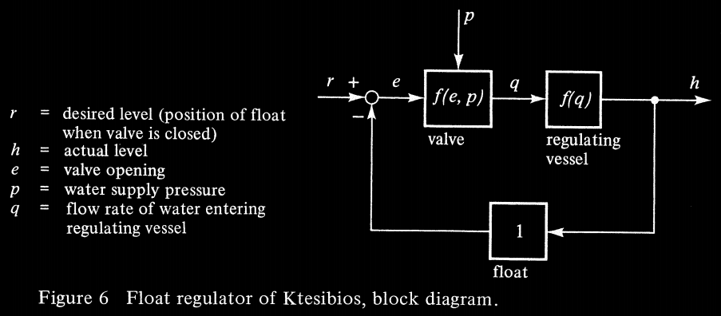
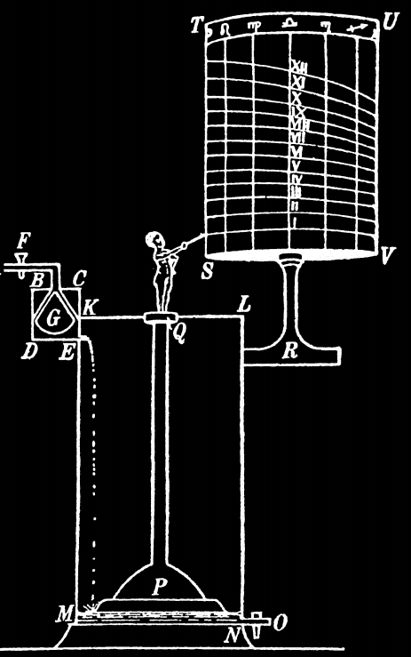
≈300 BCE

Slide 10
state of the art

Slide 11
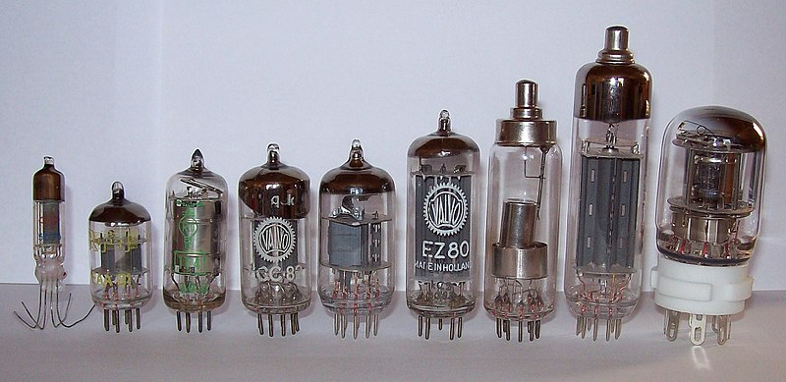
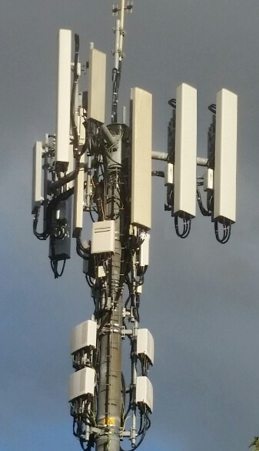
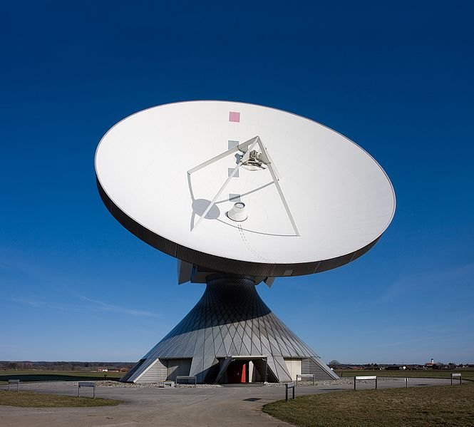
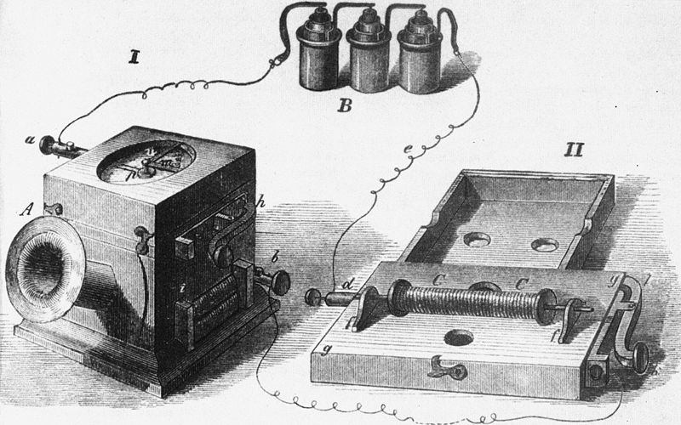
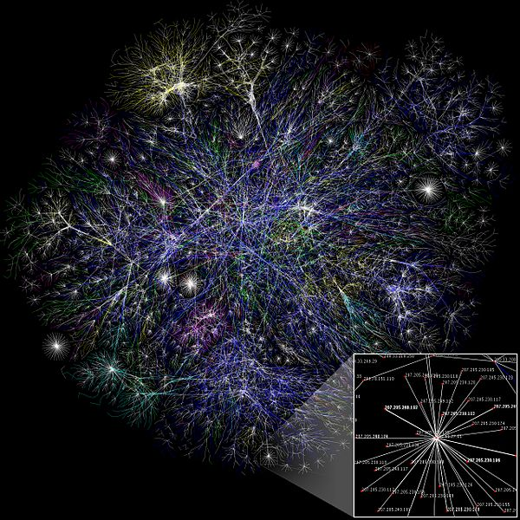
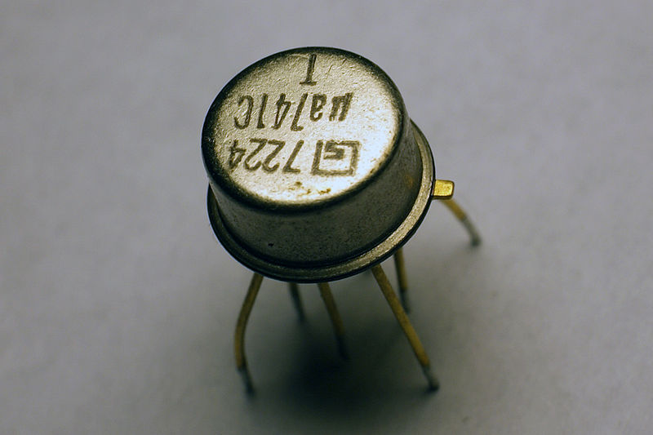
telecommunication

Slide 12
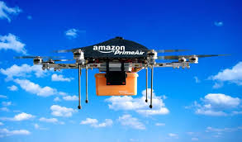
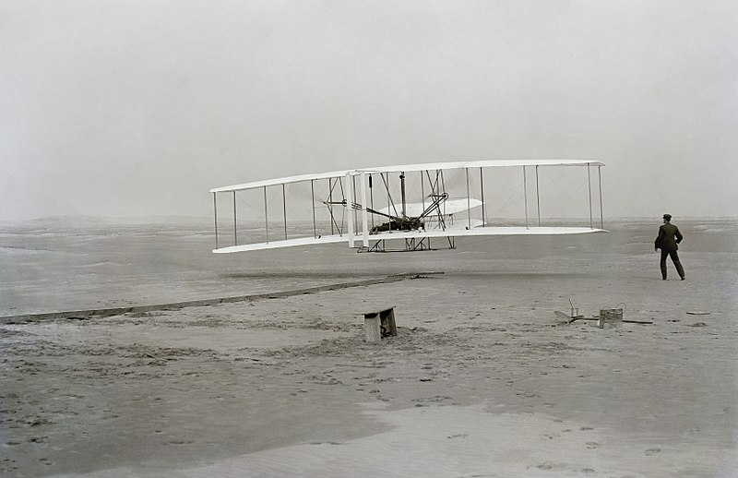
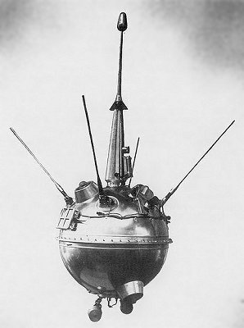


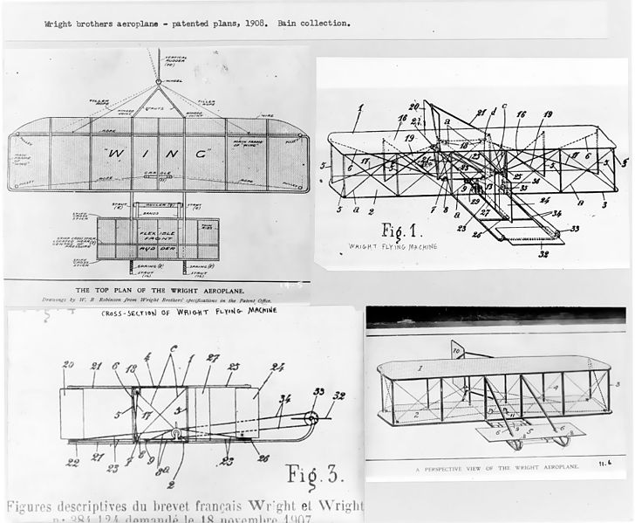
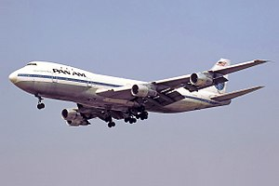
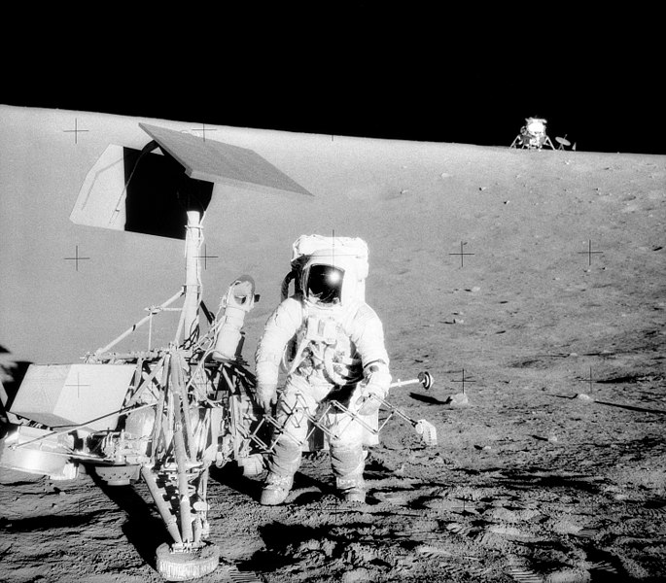
aerospace and transportation

Slide 13
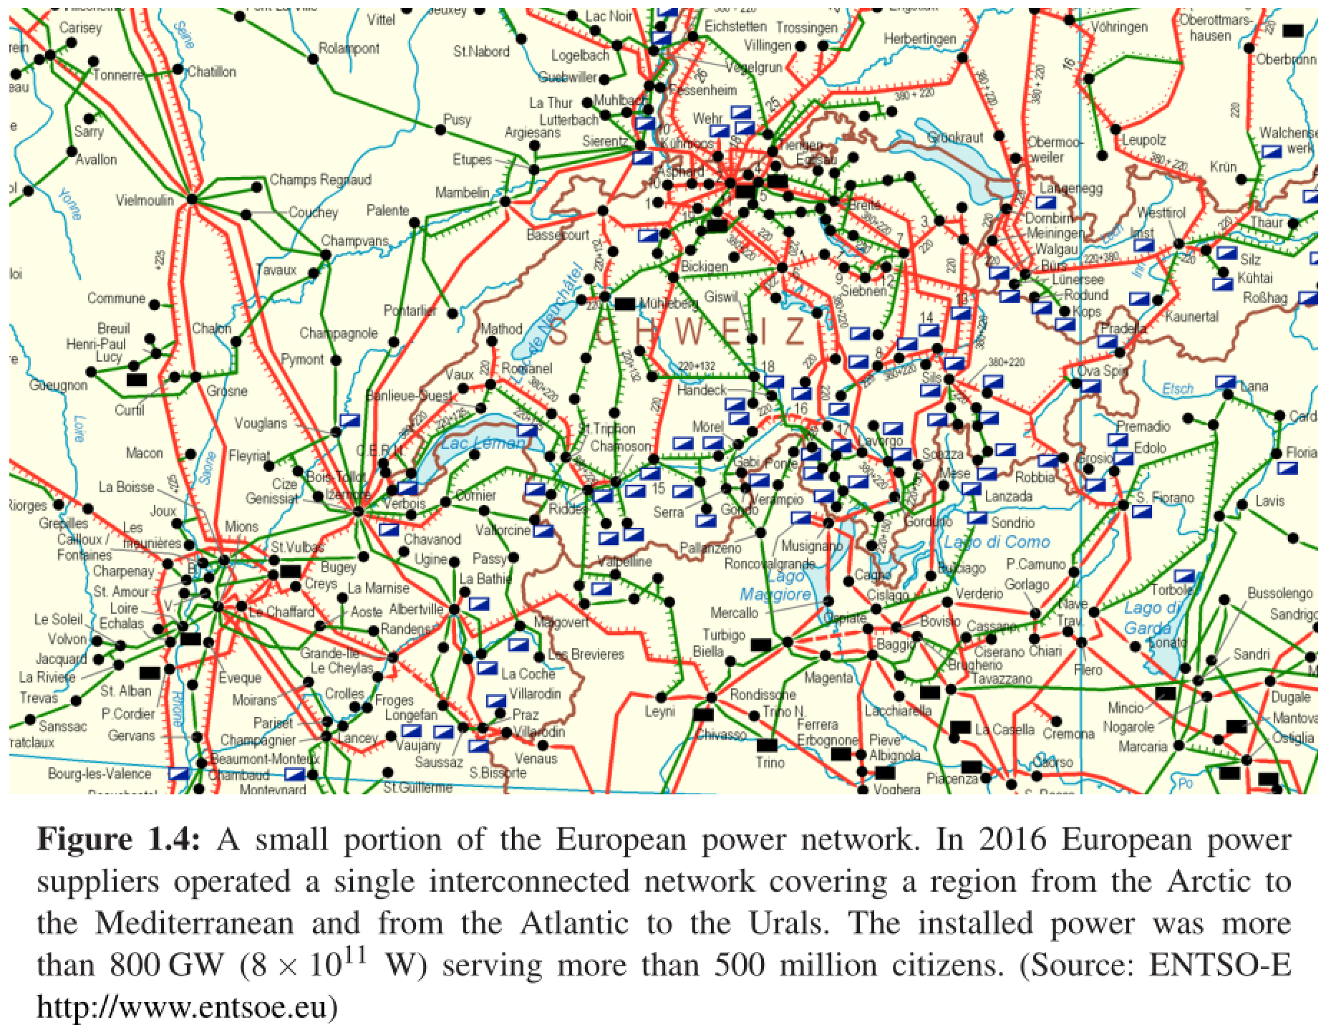
power systems – ECE 458

Slide 14

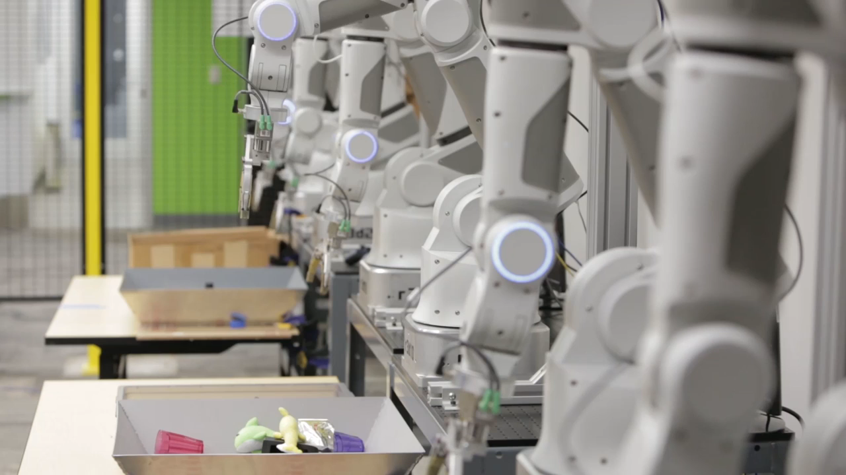

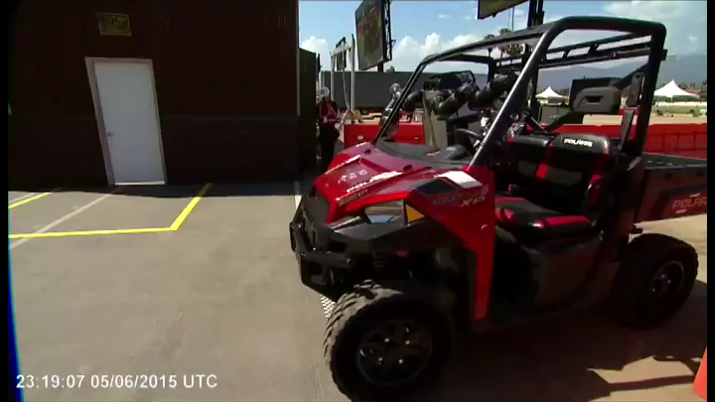
robotics and AI – ENGINE capstone

Slide 15
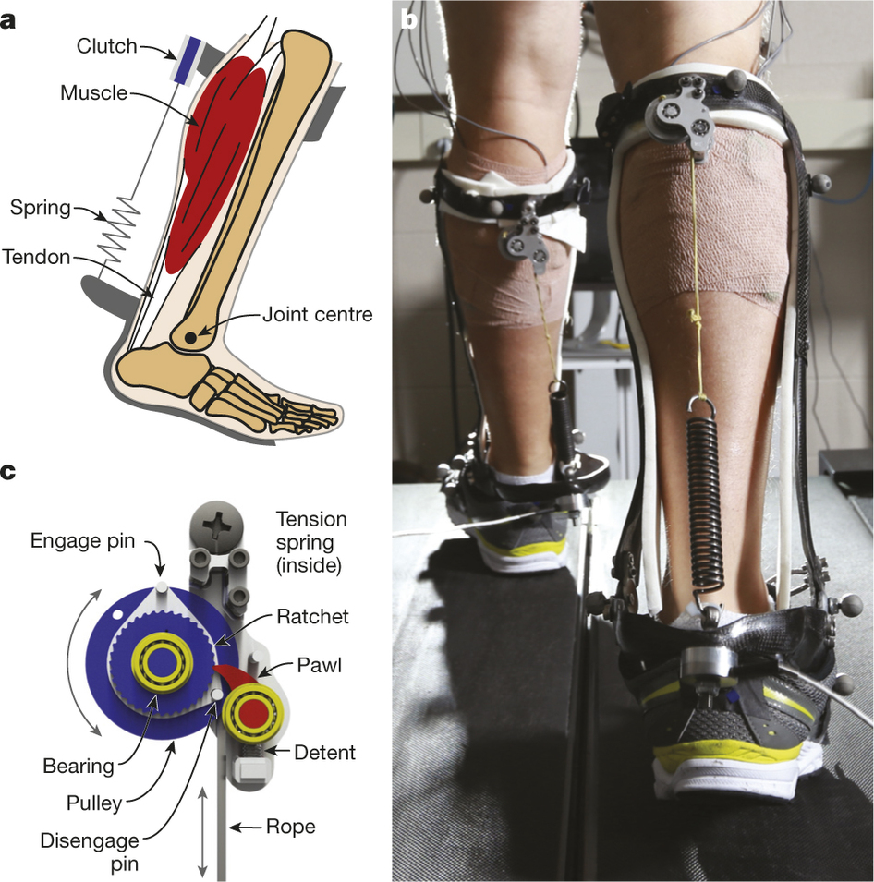
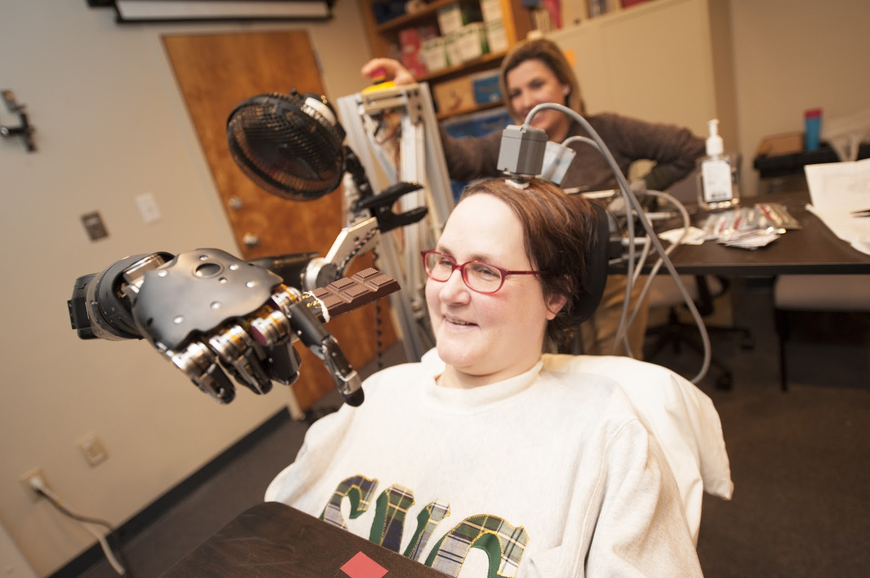
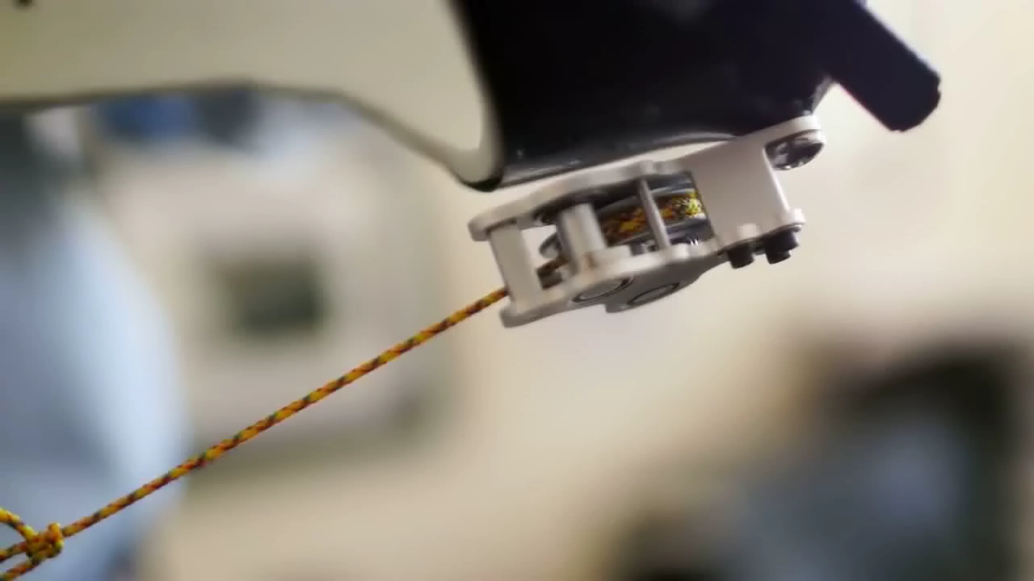
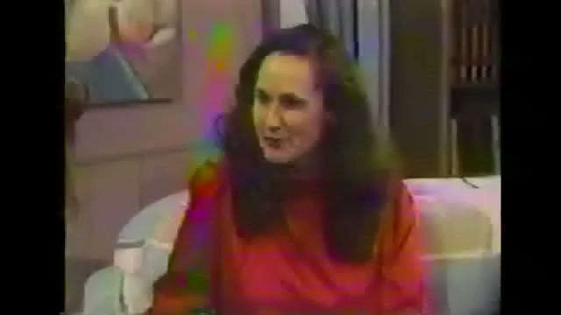
neuroengineering – ECE 466

Slide 16
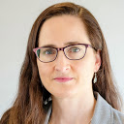
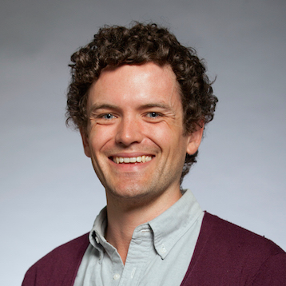
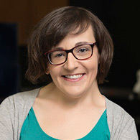
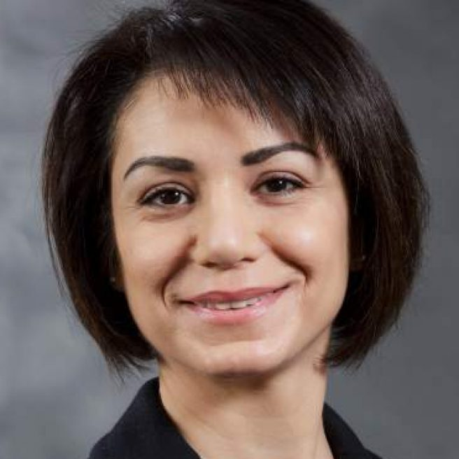
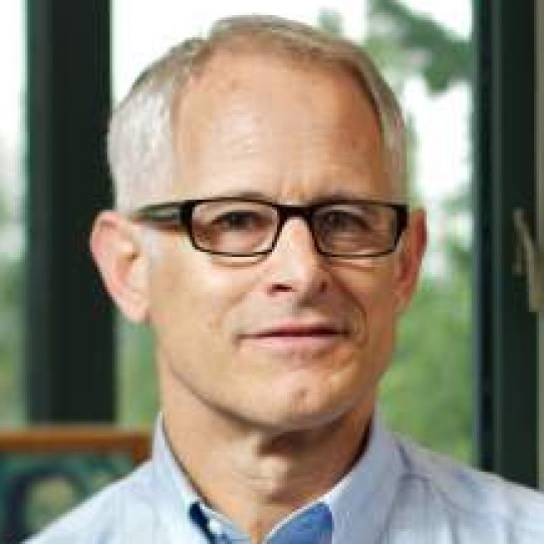

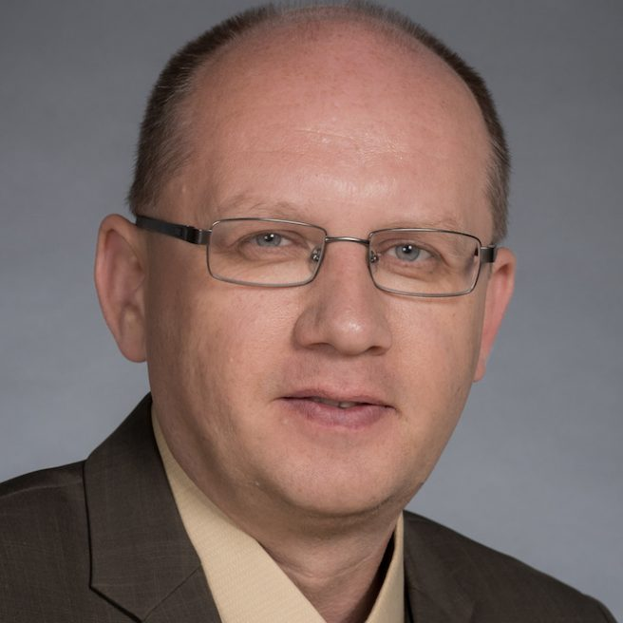
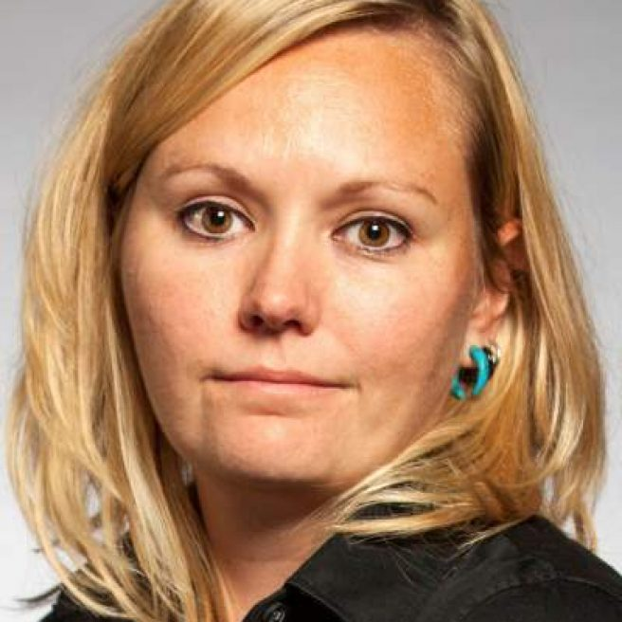
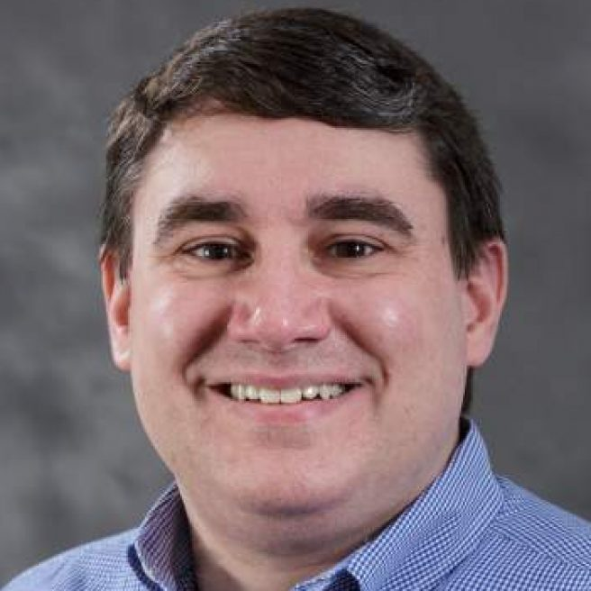
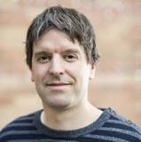
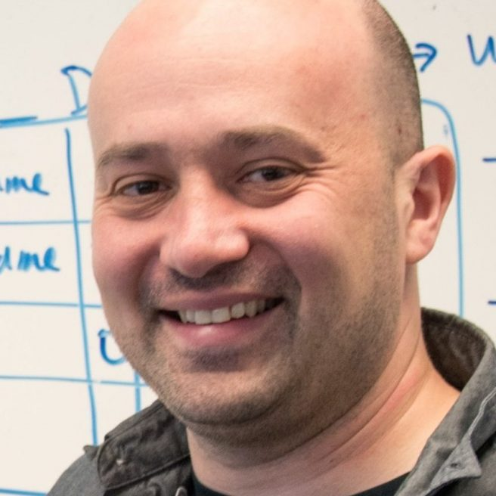
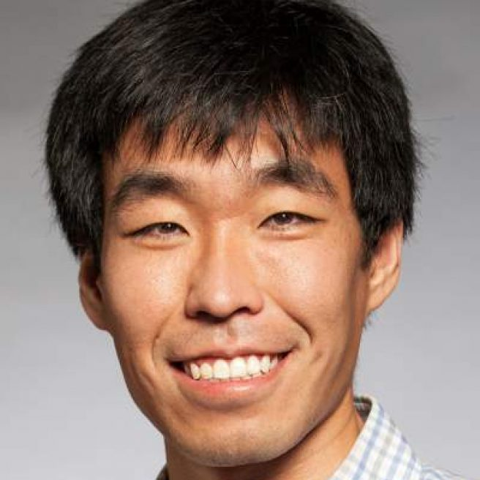
ECE controls and robotics
Prof. Linda Bushnell | networked control, cyber security
Prof. Sam Burden | sensorimotor control
Prof. Amy Orsborn | brain-computer interface (BCI)
Prof. Maryam Fazel | convex optimization
Prof. Blake Hannaford | medical robotics, telerobotics
Prof. Eric Klavins | systems biology
Prof. Alex Mamishev | sensor design and integration
Prof. Lillian Ratliff | cyber-physical systems (CPS)
Prof. Matt Reynolds | ultra-low power sensing, computation
Prof. Georg Seelig | systems biology
Prof. Eli Shlizerman | data-driven dynamical systems
Prof. Baosen Zhang | cyber-physical systems (CPS)

Slide 17
why take this course?

Slide 18
This course focuses on analysis and design of (linear) feedback control systems.
You will learn to understand and engineer control in robotics, embedded systems, electrical circuits, power systems, and biology.
We’ll build on your background in calculus, signal processing, and linear algebra, providing new analytical and computational tools.

Slide 19
learning outcomes
by the end of this course, you will be able to:
represent a linear system in state space and transfer function form;
determine the effects caused by including feedback in a system;
linearize a nonlinear system around an operating point;
determine if a system is stable;
understand sensitivity and noise/disturbance rejection properties;
apply scientific computing tools to model, design and simulate systems;
determine the performance of a system analytically and from simulation;
apply root locus, frequency response and full-state feedback methods to design a feedback control system to meet performance requirements;
design a full-state observer for a system;
apply observer + controller to estimate and stabilize a system’s state.

Slide 20
life outcomes
by the end of this course, you will be able to:
translate the physical world into equations
transform the equations to do anything you want
in effect, you will be able to ... control ... systems

Slide 21
who am I?

Slide 22
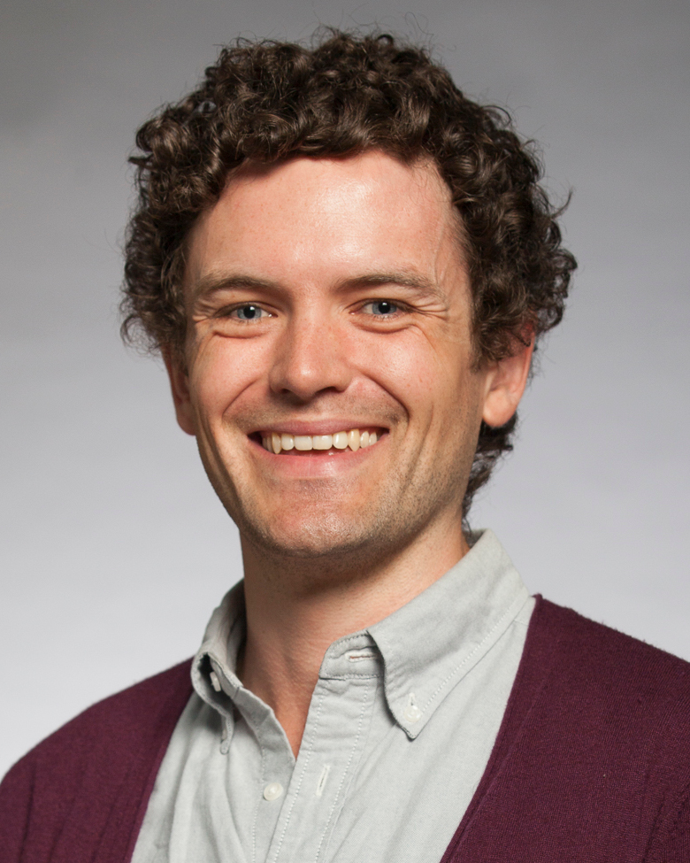
Prof Burden (he/him)
currently:
Assistant Professor in UW Seattle ECE
Associate Chair for Diversity, Equity, and Inclusion
PhD: UC Berkeley EECS 2014
BS: UW Seattle EE 2008
first-generation college grad! expertise: control theory, i.e. math of humans & machines

Slide 23
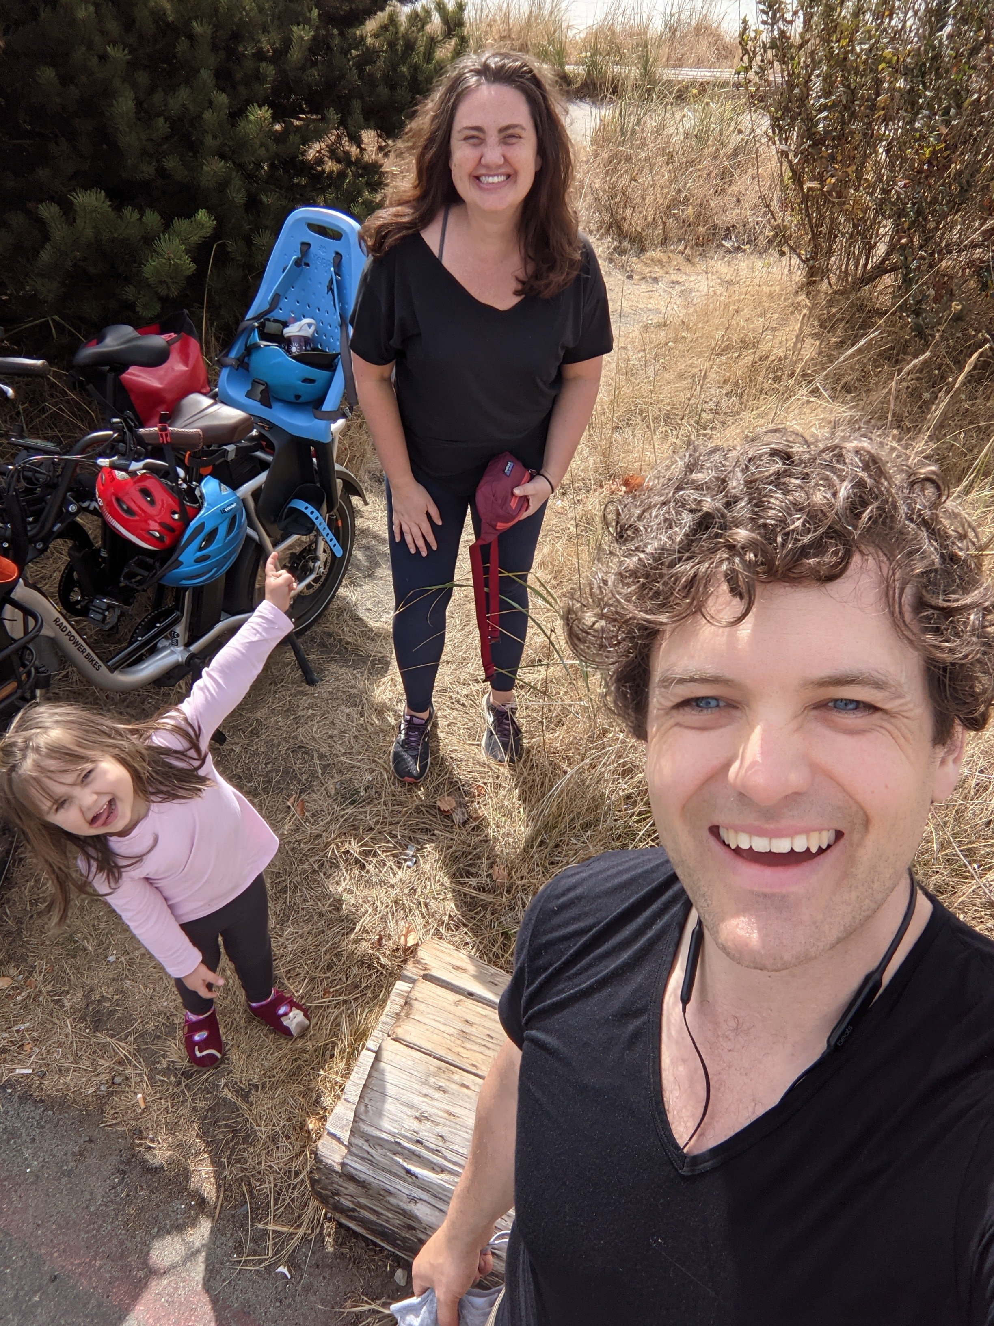
Sam (husband/dad)
born: Forks, WA
raised: Cheney, WA
likes: climbing, biking, gaming

Slide 24
we are in this together
this is an unbelievably hard time to live through
if you are struggling: you are not alone
I will work hard to support your learning if you need accommodations or face challenges
I would appreciate your understanding if I need accommodations from you
I am looking forward to learning with you!

